Slide 1
Pickup Sports
Created by: Tristan Van Hook

Slide 2
about
PickUp Sports is an app that allows users to create their own games in their community for free. Currently the most competitive atmosphere for sports are leagues that include sign up fee’s and field rentals. With PickUp Sports it has never been easier to organize a game that you love to play with the people in your area.

Slide 3
Motivation
I’m a huge sports nut
I want to create an app centered around sports and people getting active in their community.
Finding people to play your favorite sport can be tough, this makes it easier.
Personal Use

Slide 4
Technologies Implemented
MERN Stack (MongoDB, Express, React, Node.js)
CSS
Axios
Yarn
Mongoose
Javascript
Get, Post, Update, Delete
Heroku
Mlab

Slide 5
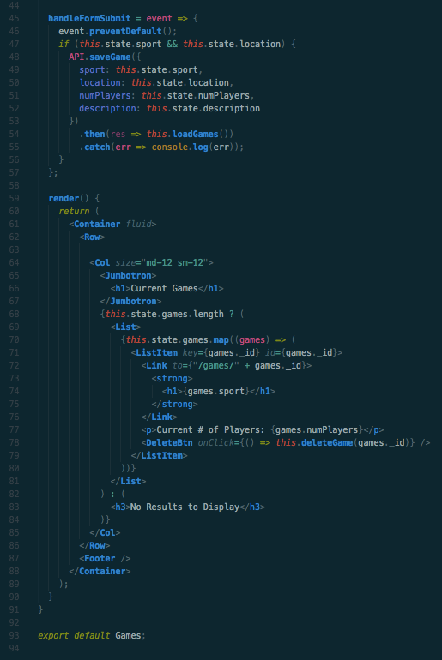
Clean Code

Slide 6
How it works!
The app launches on the home page with an about section and a how-to
Create the PickUp game of your choosing by entering the sport being played, location of game, number of players and a brief description.
The PickUp game is then posted to the games database and is visible on the games page.
The locations page shows the current location of all current PickUp games.

Slide 7
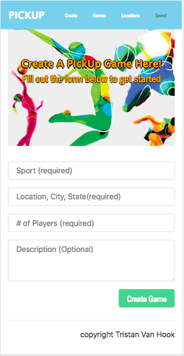
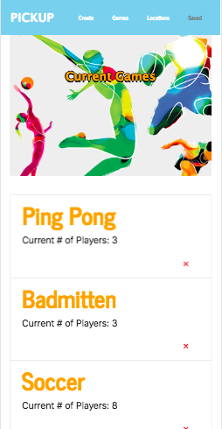
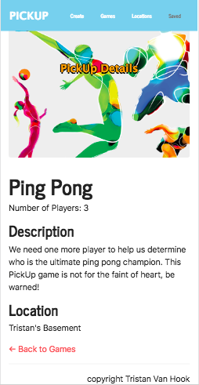

Slide 8
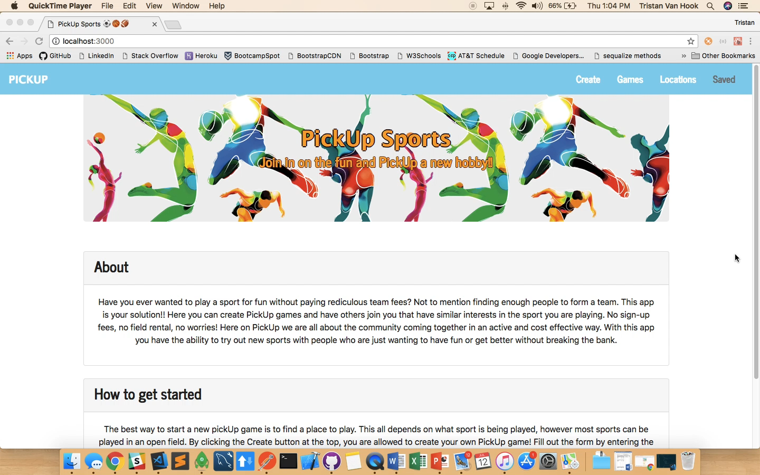

Slide 9
Future Implementation
Google Maps for locations page
Saved page for games that were saved by user
Login system
Notifications for users
Players needed for game
Join button that changes the players needed and total number of players.
Page for rules of all sports for players to reference.

